Slide 1
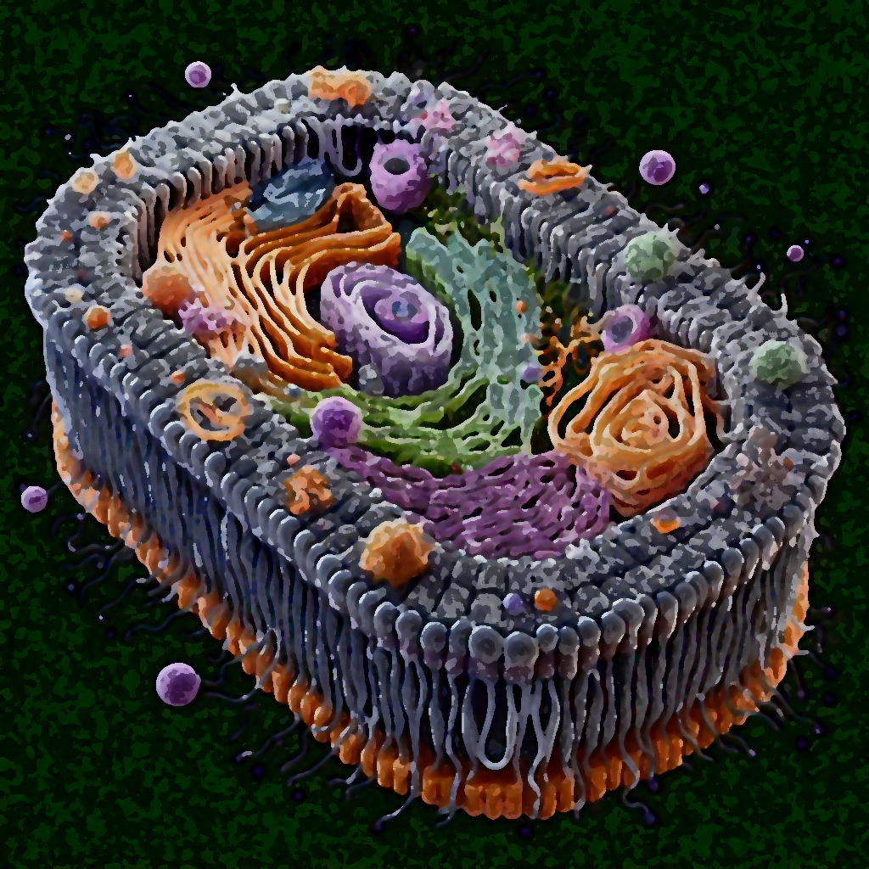
Sphingolipid domains in fibroblast studies
Emile Chauvel, Ami De Carli, Aldric Mercier

Slide 2
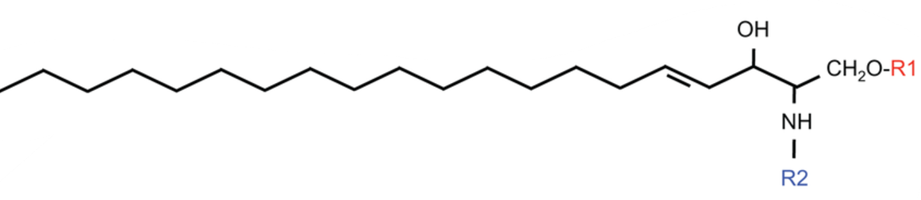
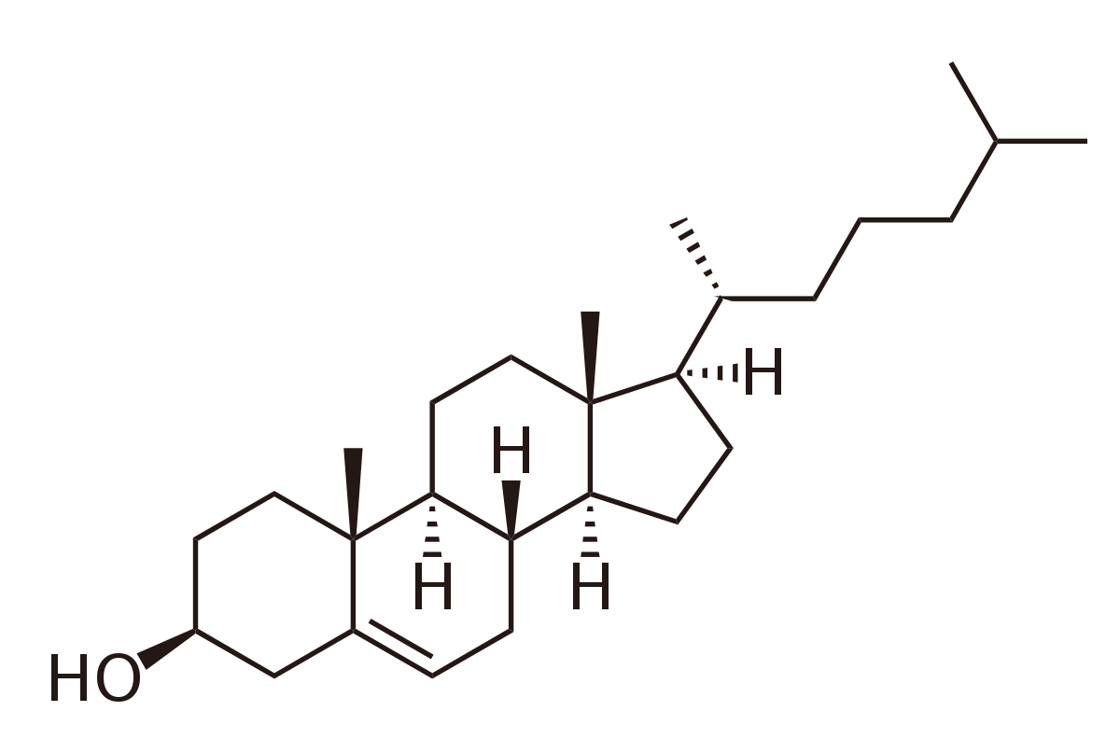
Sphingolipids and Cholesterol
Sphingolipid
Cholesterol

Slide 3
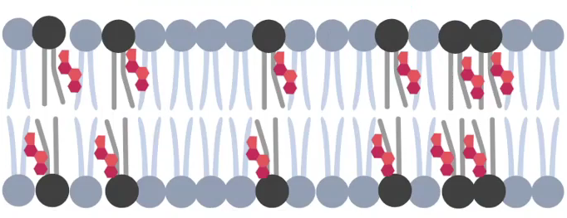
Lipid rafts
Sphingolipid
Cholesterol
Small domains (~ 200 nm)
Dynamic
Enriched with sphingolipids and cholesterol

Slide 4
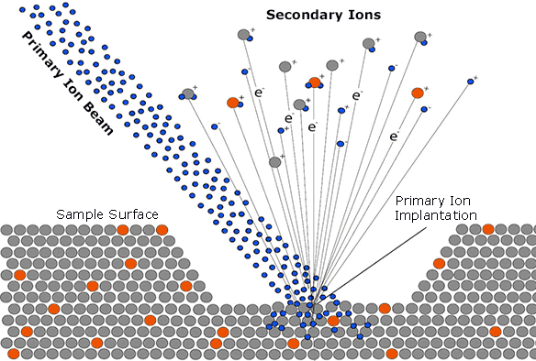
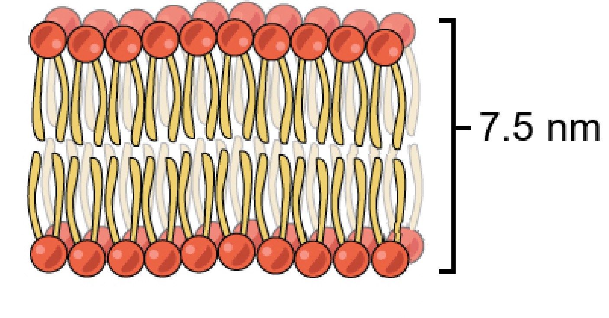
SI-MS
Only external part of bilayer excitation (2 nm)
Needs internal normalization
Scans surface to obtain image
https://www.cameca.com/products/sims/technique

Slide 5
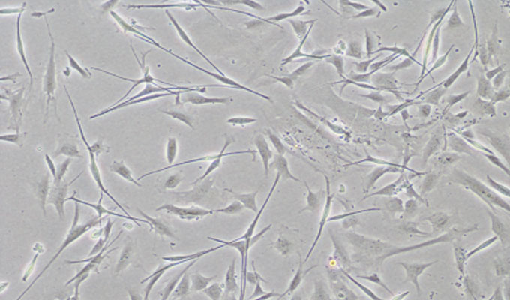
https://acikders.ankara.edu.tr/pluginfile.php/80060/mod_resource/content/0/Temel%20Ara%C5%9Ft%C4%B1rma%20Teknikleri-5.%20hafta.pdf

Slide 6
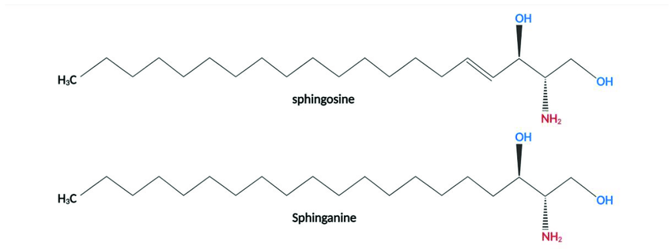

Enrichment in radioisotopes
Feed the fibroblast with ${}_{ }^{15}N$-sphingosine and sphinganine
Feed with ${}_{ }^{13}C$-labeled fatty acids
80 % incorporation of ${}_{ }^{15}N$
80 % incorporation of ${}_{ }^{13}C$
<2 % diffusion of ${}_{ }^{15}N$ into non-sphingolipid species

Slide 7
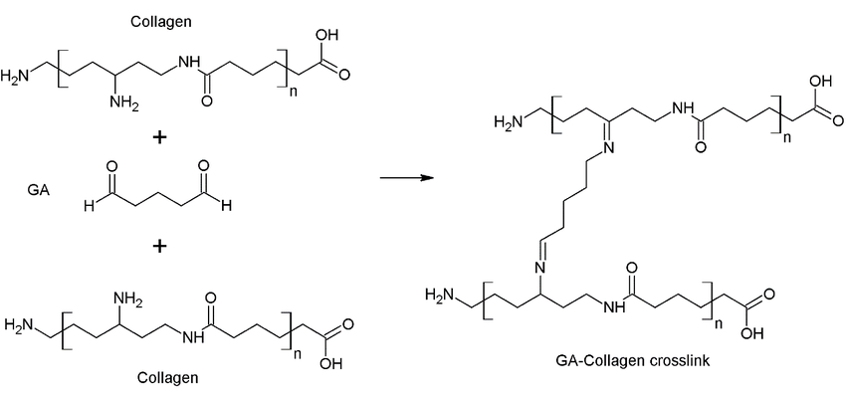
Glutaraldehyde fixation
Are Natural Compounds a Promising Alternative to Synthetic Cross-Linking Agents in the Preparation of Hydrogels? January 2023, Pharmaceutics 15(1):253

Slide 8
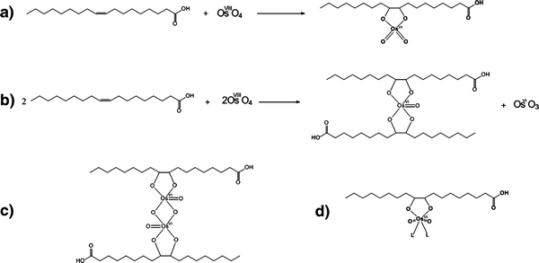
Osmication for lipid crosslink
Belazi, D., Solé-Domènech, S., Johansson, B. et al. Chemical analysis of osmium tetroxide staining in adipose tissue using imaging ToF-SIMS. Histochem Cell Biol 132, 105–115 (2009).

Slide 9
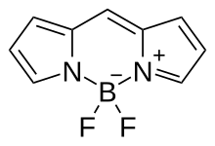
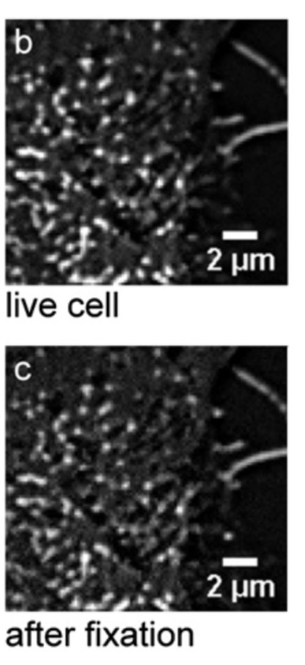
Experiment 1: no alteration by Chemical Fixation
Fluorescent sphingolipid analog: (BODIPY)-sphingosine
Then glutaraldehyde fixation and compare by TIRFM
Tested at different temperatures
Glutaraldehyde

Slide 10
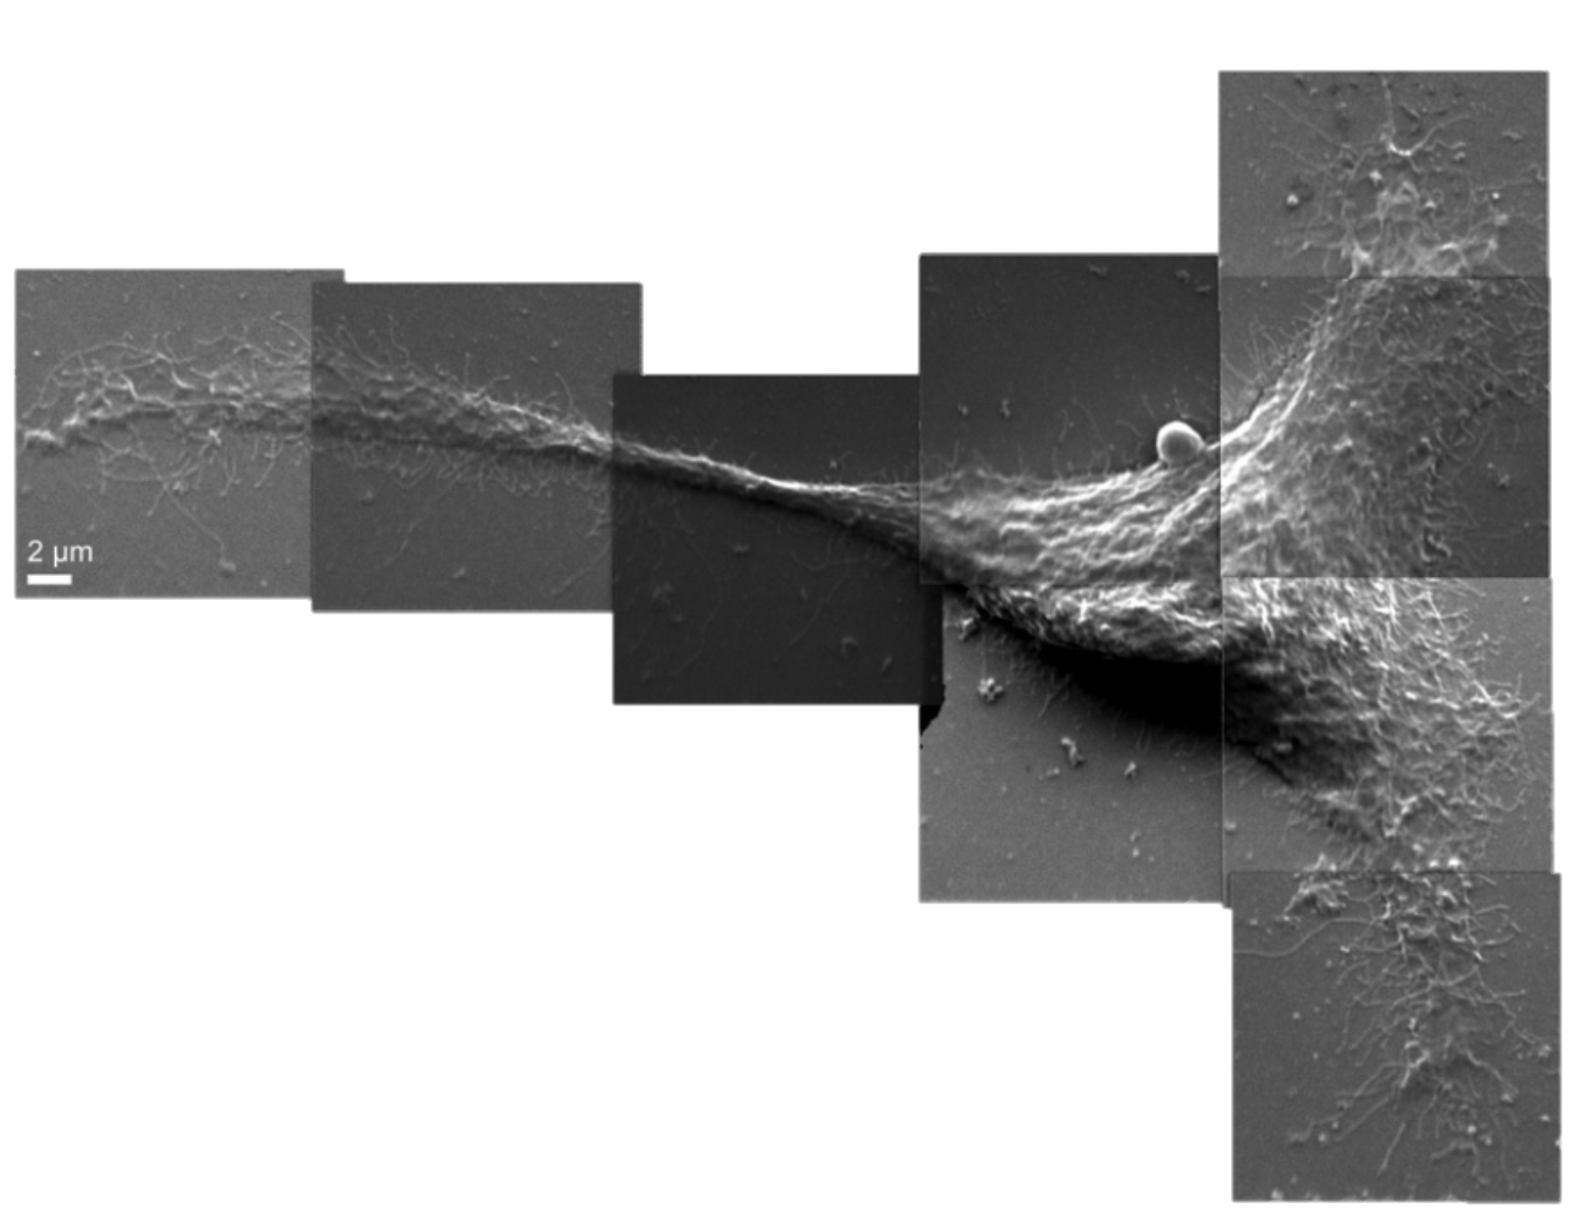
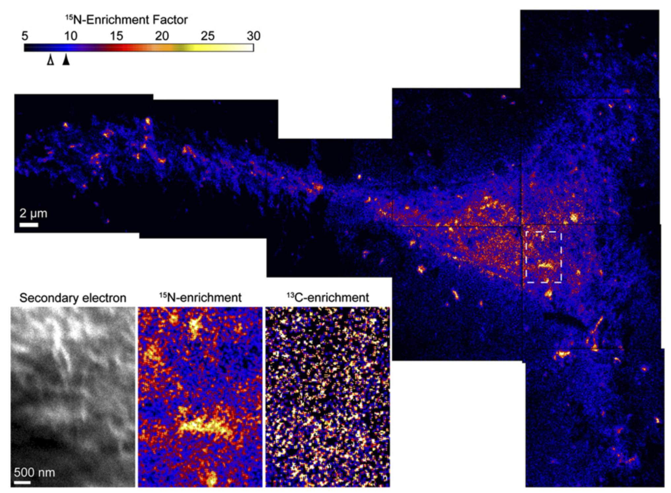

Experiment 2: Sphingolipid Domains Cartography
Look at ${}_{ }^{15}N$ concentration and distribution on surface using SI-MS of modified fibroblast
Statistical distribution test

Slide 11
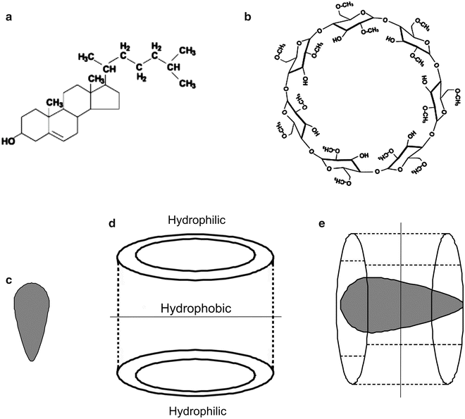
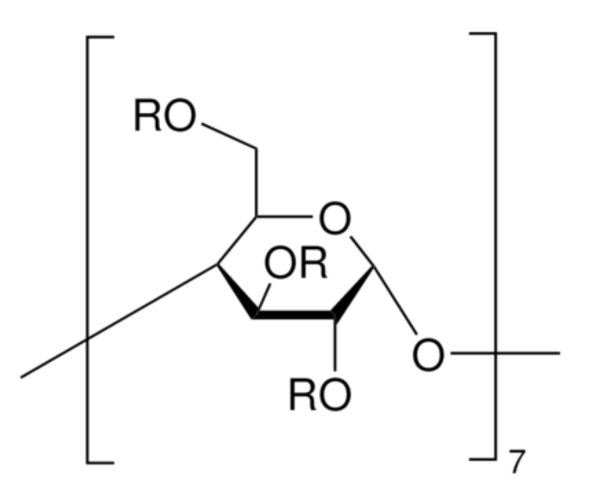
Experiment 3: Cholesterol depletion effect
Deplete the cholesterol concentration of PM
Use Methyl-ϐ-cyclodextrin
30 % reduction in cholesterol before fixation

Slide 12
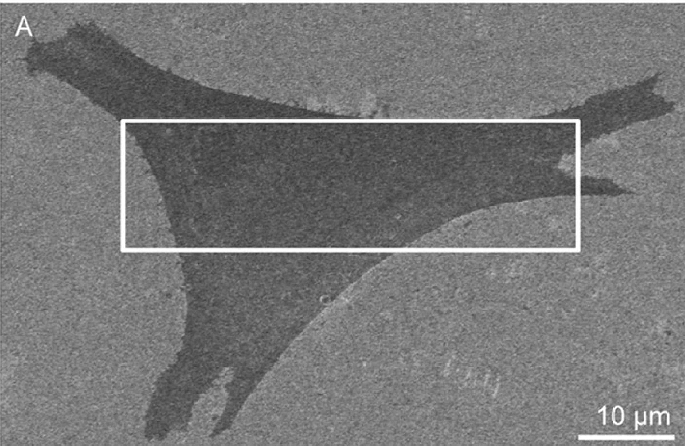
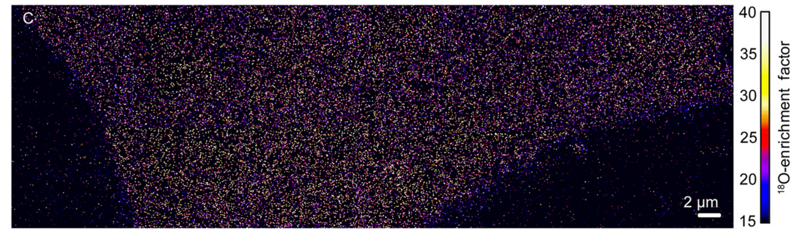

Experiment 4: Cholesterol mapping
Feed fibroblasts with ${}_{ }^{18}O$ cholesterol
60 % incorporation of ${}_{ }^{18}O$
Look at distribution

Slide 13
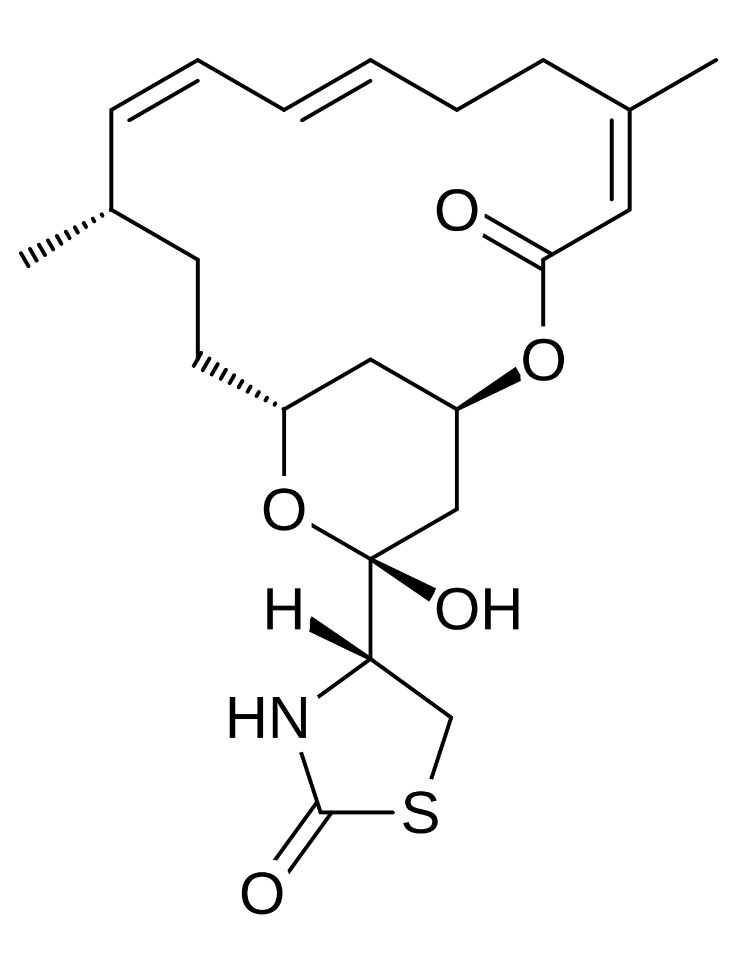
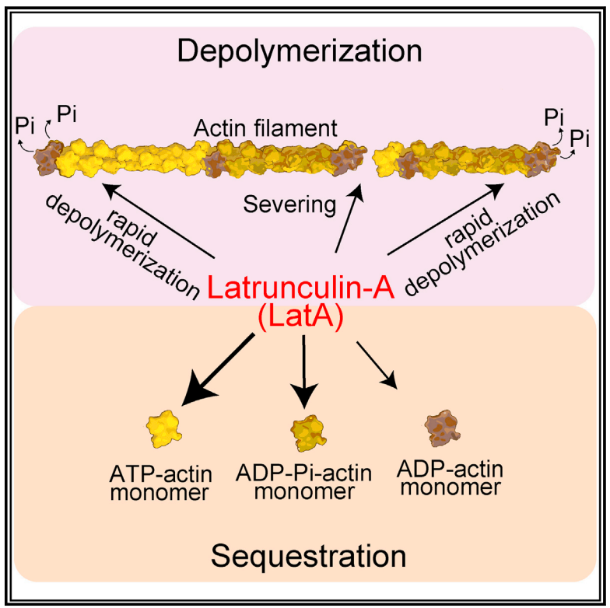
Experiment 5: Cytoskeleton destruction effect
Destroy cytoskeleton using actin-depolymerizing drug
C. Sullivan, Effects of Actin-Destabilizing Drugs on
Motor Function in Drosophila melanogaster
Latrunculin A

Slide 14
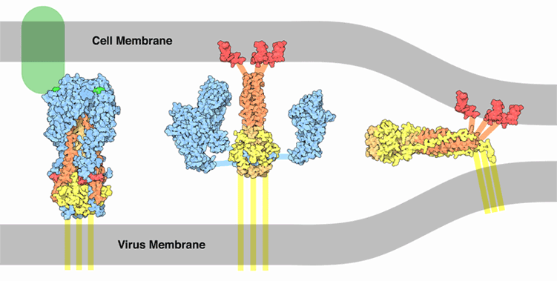
Experiment 6: Hemagglutinin interaction
Hemagglutinin: influenza protein that binds to cells membrane
Look by fluoroscopy if Hemagglutinin places itself on domains
Look if it changes sphingolipid distribution
Kamal, Aisha & H, ISLAM & Ahmad, Iffat. (2010). Hydroxyl Free Radical Scavenging Activity of Nigella Sativa L. Seed Extracts in various Germinating Stages under Cadmium Stress. International Journal of Biological Sciences and Engineering.

Slide 15
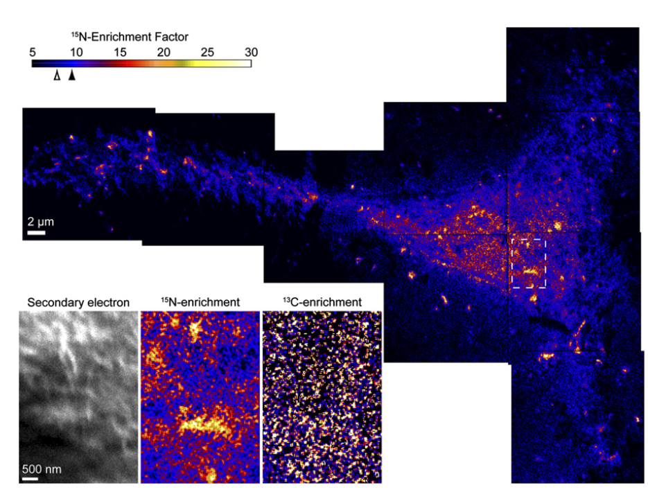
Results and discussions

Slide 16
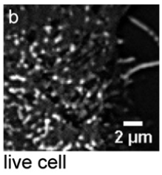
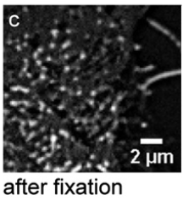
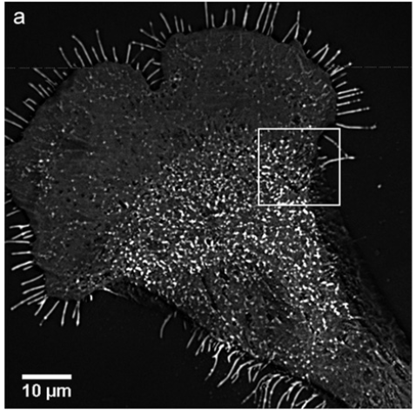

Results of experiment 1
Glutaraldehyde did not cause clusters to form
or
Confirm that ${}_{ }^{15}N$-domains not from organelles

Slide 17
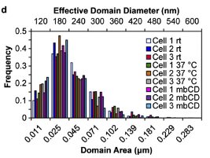
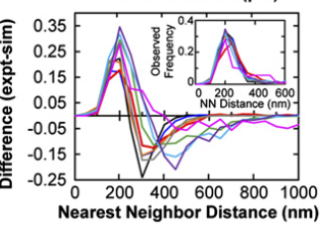
Results of experiment 1
The temperature does not play any role
                Neither Area and
              frequency changed

Slide 18
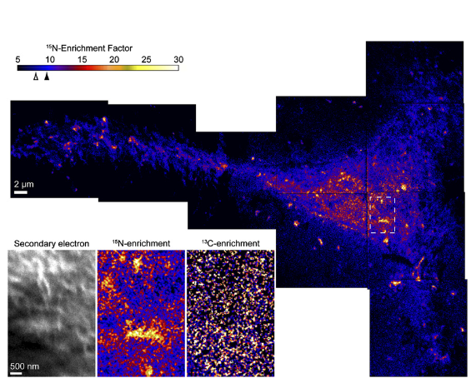
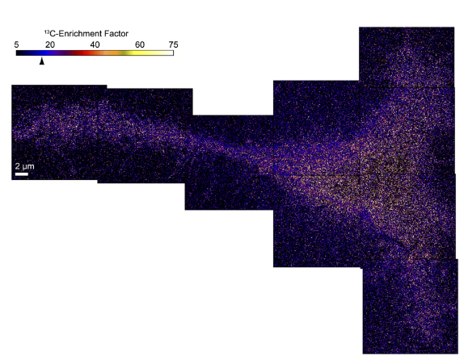
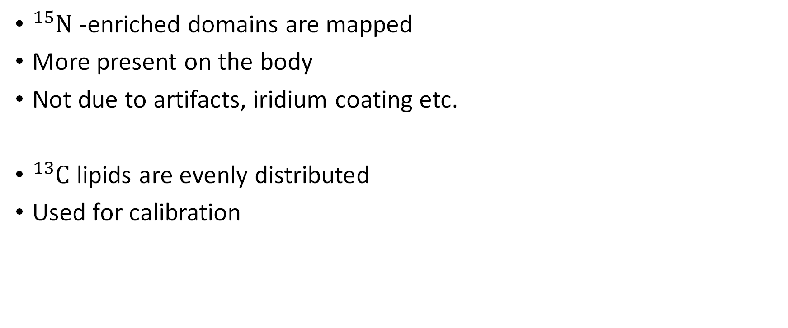
Results of experiment 2
${}_{ }^{15}N$-enriched domains are mapped
More present on the body
Not due to artifacts, iridium coating etc.
${}_{ }^{13}C$ lipids are evenly distributed
Used for calibration

Slide 19
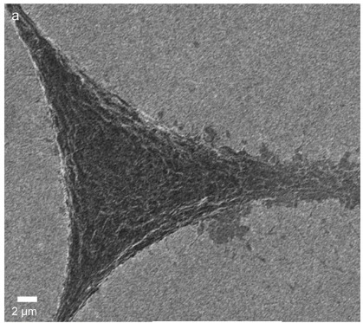
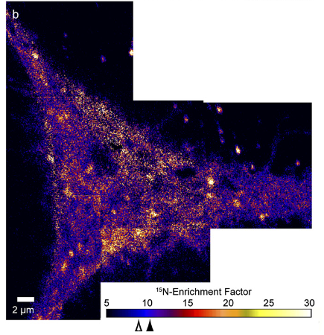
Results of experiment 3
Cholesterol depletion has no effects on the cell structure
Cytoskeleton not affected
Clusters at the same place and size
Weakening of long-range interactions but not of short-range ones

Slide 20
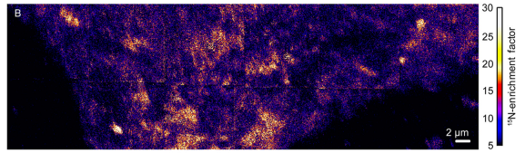
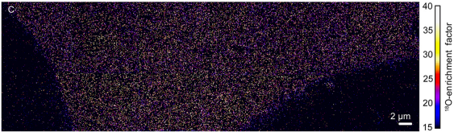

Results of experiment 4
${}_{ }^{15}N$-enriched domains VS ${}_{ }^{18}O$ -enriched Cholesterol mapping

Slide 21
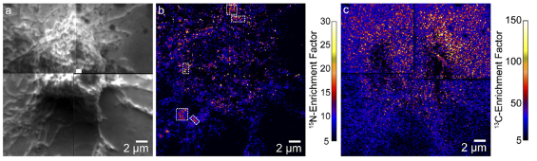
Results of experiment 5
Cytoskeleton is important (obligatory)
Without:
-randomly positioned clusters
- Very small in number and size

Slide 22
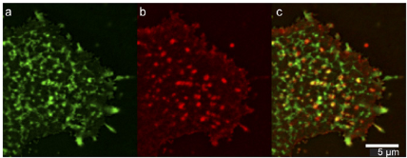

Results of experiment 6
Hemagglutinin-sphingolipids interaction not important
${}_{ }^{15}N$-enriched domains still seen without Hema.

Slide 23
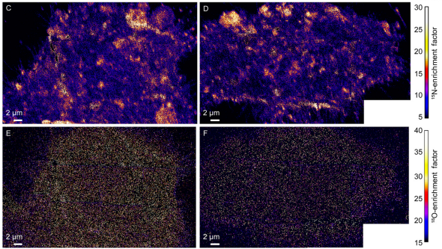
Results of experiment 6
Tests on cell with/without Hemagglutinin
Very slight clustering effect (not significant)

Slide 24
Conclusions
Sphingolipids are organized in microdomains
They are independent of cholesterol enrichment
The cytoskeleton is important in maintaining these structures
Cholesterol only has a minor, indirect influence on these domains
Hemagglutinin has no effect on cholesterol or sphingolipids distribution

Slide 25
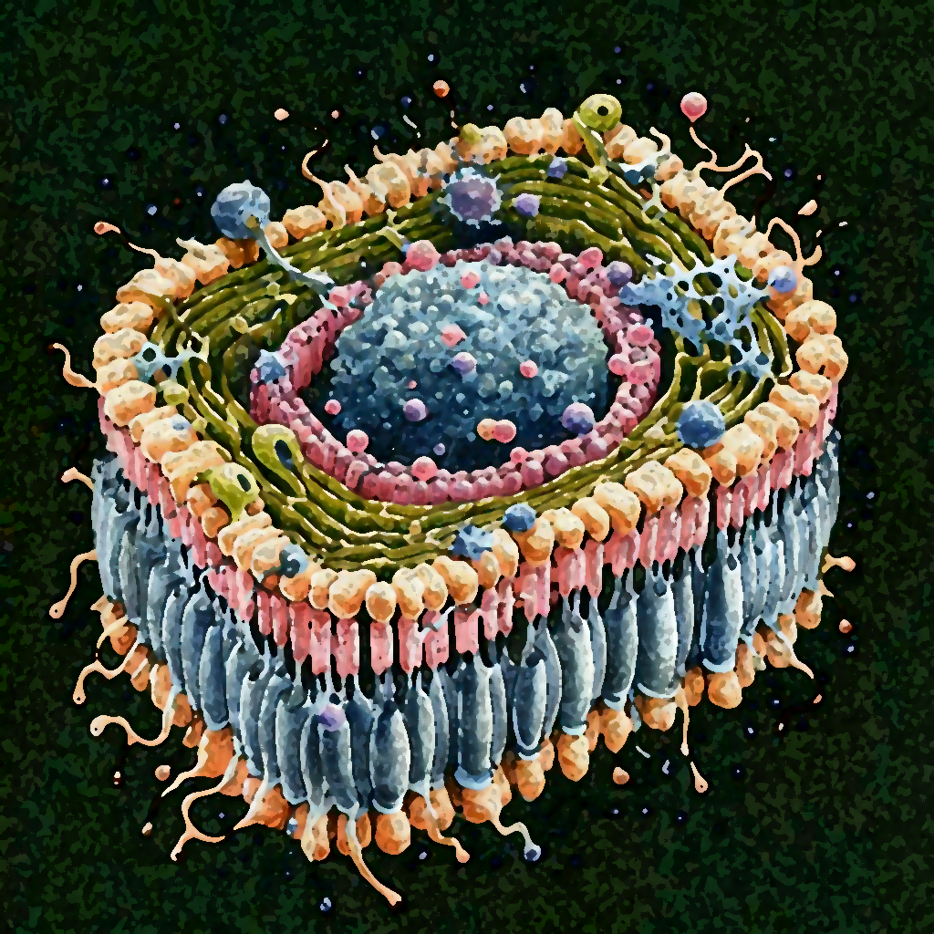
Take at home message
There are Sphingolipids microdomains, but they are not lipid rafts and cholesterol has no direct influence on them.

Slide 26
Main article reference
J.F. Frisz, K. Lou, H.A. Klitzing, W.P. Hanafin, V. Lizunov, R.L. Wilson, K.J. Carpenter, R. Kim, I.D. Hutcheon, J. Zimmerberg, P.K. Weber, M.L. Kraft, Direct chemical evidence for sphingolipid domains in the plasma membranes of fibroblasts, Proc. Natl. Acad. Sci. U.S.A. 110 (8) E613-E622, https://doi.org/10.1073/pnas.1216585110 (2013).
Frisz, J. F., Klitzing, H. A., Lou, K., Hutcheon, I. D., Weber, P. K., Zimmerberg, J., & Kraft, M. L. (2013). Sphingolipid domains in the plasma membranes of fibroblasts are not enriched with cholesterol. The Journal of biological chemistry, 288(23), 16855–16861. https://doi.org/10.1074/jbc.M113.473207

